Slide 1


DMart Sales Data Analysis Using PySpark
This project utilizes PySpark to analyze DMart sales data. The pipeline processes, cleans, and joins data from CSV files. Ten analytical business questions are answered, providing actionable insights. The results are delivered in a tabular format.
by Yash Dalvi

Slide 2
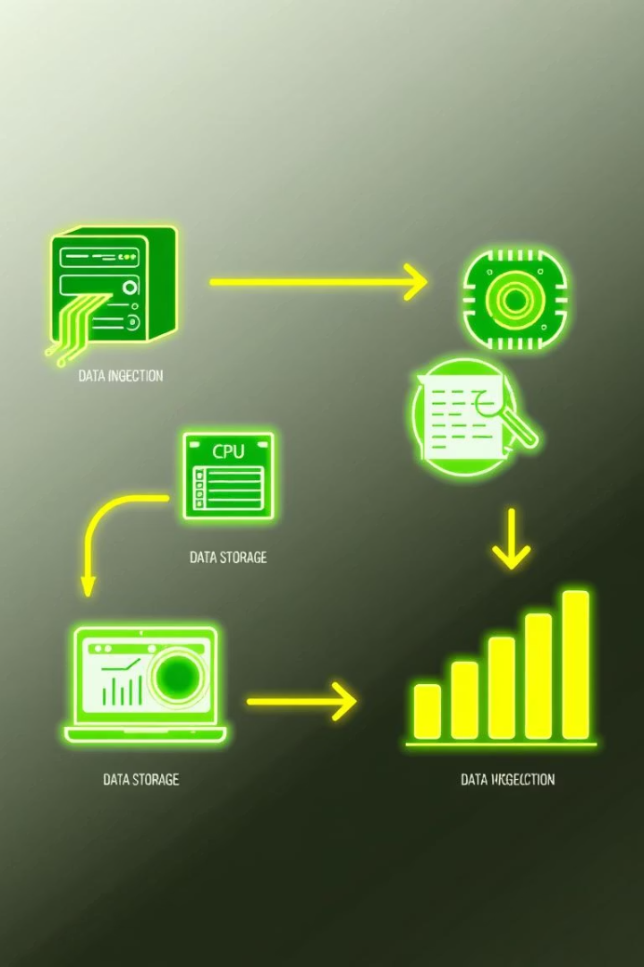
Project Overview
1
Initialization
2
Data Loading
Start a PySpark session to enable distributed data processing.
Load CSV files into DataFrames for transformation.
3
Transformation
Clean, transform, and integrate DataFrames.

Slide 3




Technologies Used
Python
Core scripting language for data processing.
PySpark
For distributed data processing and Spark SQL.
Jupyter
Interactive execution and PDF export.

Slide 4
Dataset Structure
Products.csv
Sales.csv
Customers.csv
Product ID
Order Line
Customer ID
Category
Order ID
Customer Name
Sub-Category
Order Date
Segment
Product Name
Customer ID
Age

Slide 5
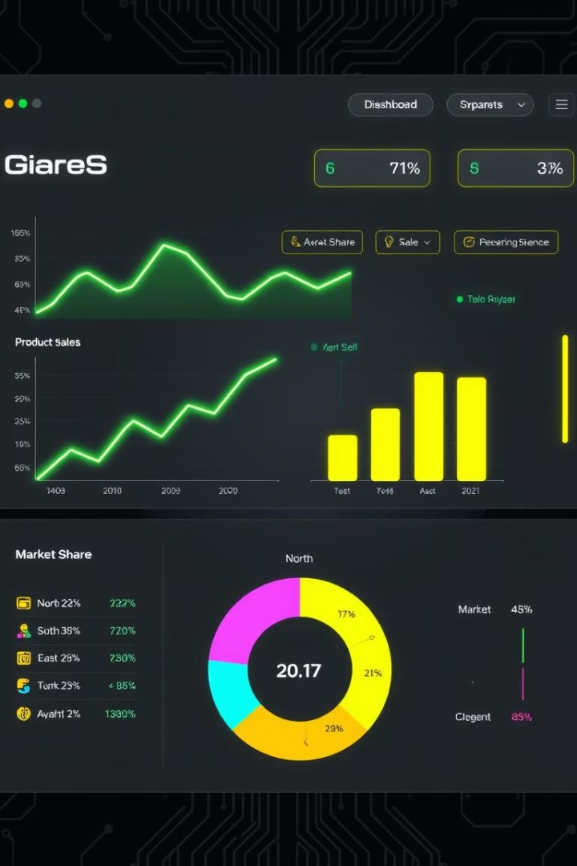



Analytical Questions
Sales by Category
Total sales for each product category.
Top Customer
Customer with the highest purchases.
Average Discount
Average discount given across all sales.

Slide 6

More Questions Explored
Unique Products by Region
Total Profit by State
Identifies product distribution trends.
Reveals profitable markets.
Sales by Sub-Category
Highlights top-performing sub-categories.

Slide 7




Further Analysis
Average Customer Age
1
Orders by Shipping Mode
2
Profit by Customer Segment
4
3
Quantity Sold by City

Slide 8




Key Insights
Revenue Drivers
Customer Behavior
High-sales categories indicate key product lines.
Top purchasers suggest loyalty program opportunities.
Profitability
Highlights strong markets regionally.

